Slide 1
What matters for central bankers and what matters for the financial market?
Preliminary results of a Latent Dirichlet Allocation analysis of ECB speeches and data analysis of European countries.

Slide 2
What matters for central bankers and what matters for the financial market?
Why is this important?
Understanding the relationship between market signals and central bank priorities
helps explain how policy and market perceptions interact.
If financial markets and policymakers focus on different risks,
this may lead to mispricing, policy uncertainty, or weaker policy transmission.
Identifying these differences improves our understanding of
monetary policy credibility and financial market reactions.
Strategy
Financial market
Sovereign spreads signal how markets evaluate macroeconomic fundamentals such as
GDP growth, competitiveness (REER), fiscal sustainability (Debt/GDP) , and international vouneralability (Currrent account)
Central bankers
Speeches serve as a proxy for the issues policymakers consider most relevant.

Slide 3
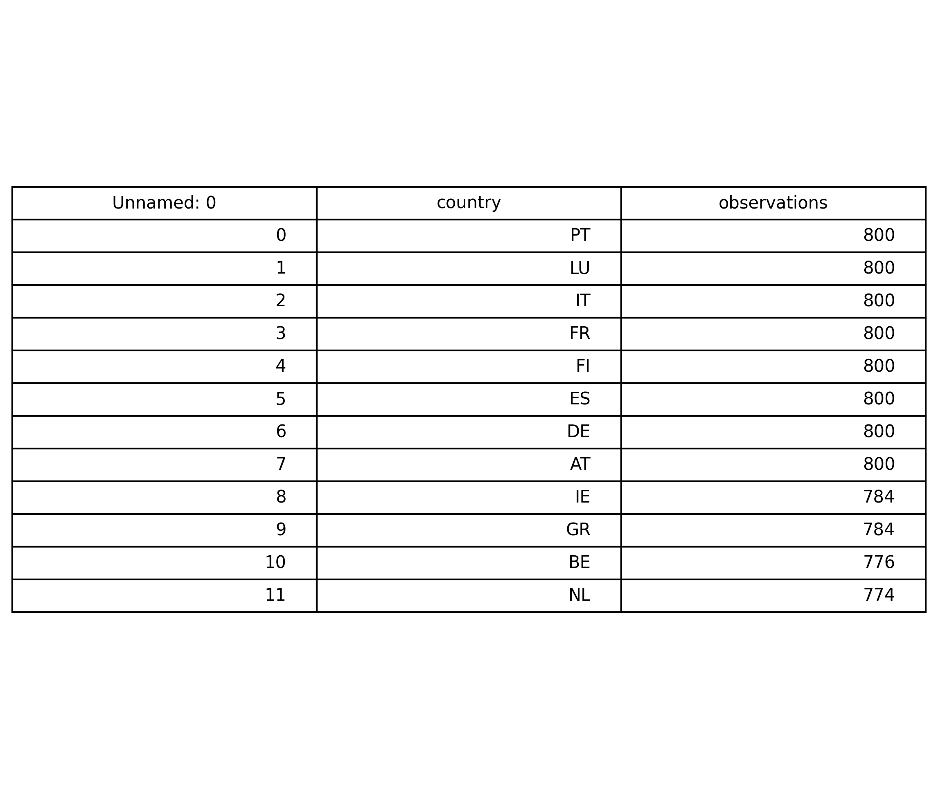
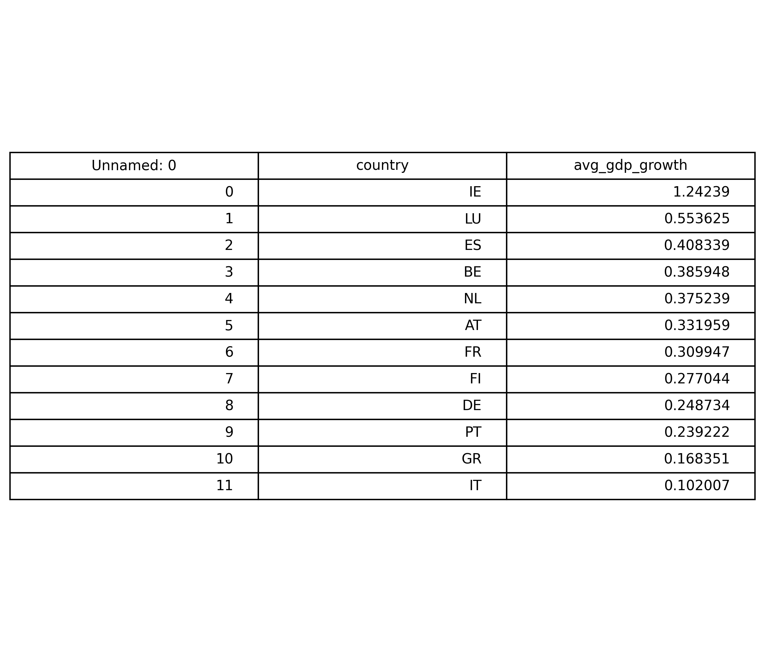
Observations and Average GDP Growth
Our analysis focused on 11 countries in the EU: Portugal, Lithuania, Italy, France, Finland, Spain, Germany, Austria, Ireland, Greece, Belgium, and the Netherlands.
Most countries (7) had 800 observations in the dataset, whereas the others had 784 (Ireland and Greece), 776 (Belgium), and 774 (the Netherlands).
Our analysis also shows the average GDP. Almost all countries' GDP growth is below 1, except Ireland’s, whose GDP growth is 1.24.

Slide 4
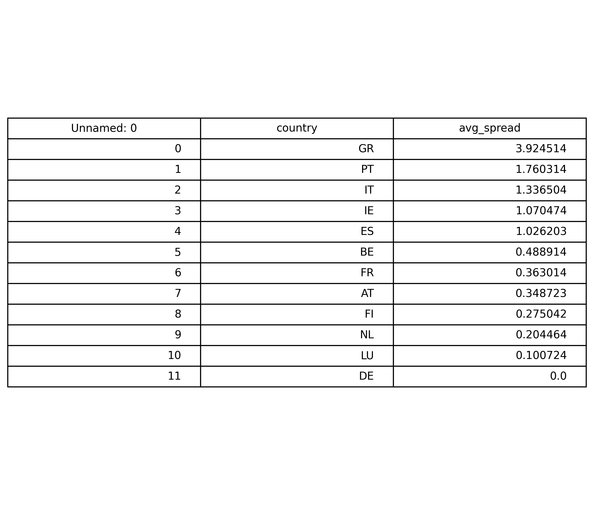
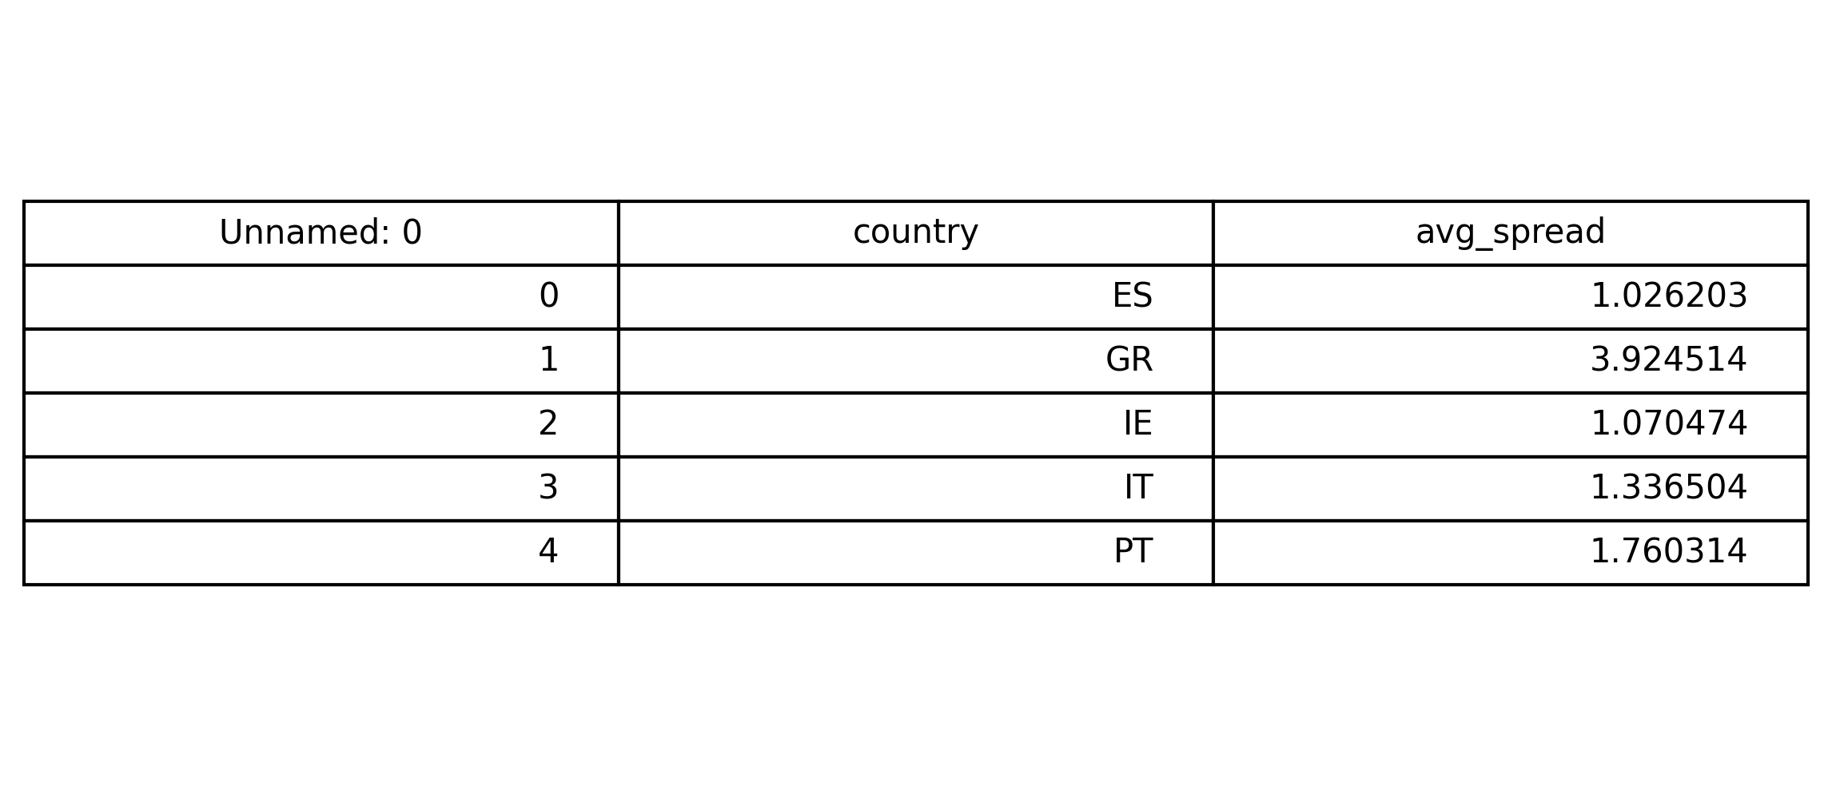
Average Spread in the Data
Our analysis focused on the average spread. The country with the highest average spread was Greece (around 3.92), whereas the country with the lowest spread was Germany (0). Both the highest and lowest spread countries are significantly different from the other countries, whose spread is around 0.5-1.7.
Our analysis also shows the countries whose average spread is above the overall average spread in the dataset. Namely, these countries are Spain, Greece, Ireland, Italy, and Portugal.

Slide 5
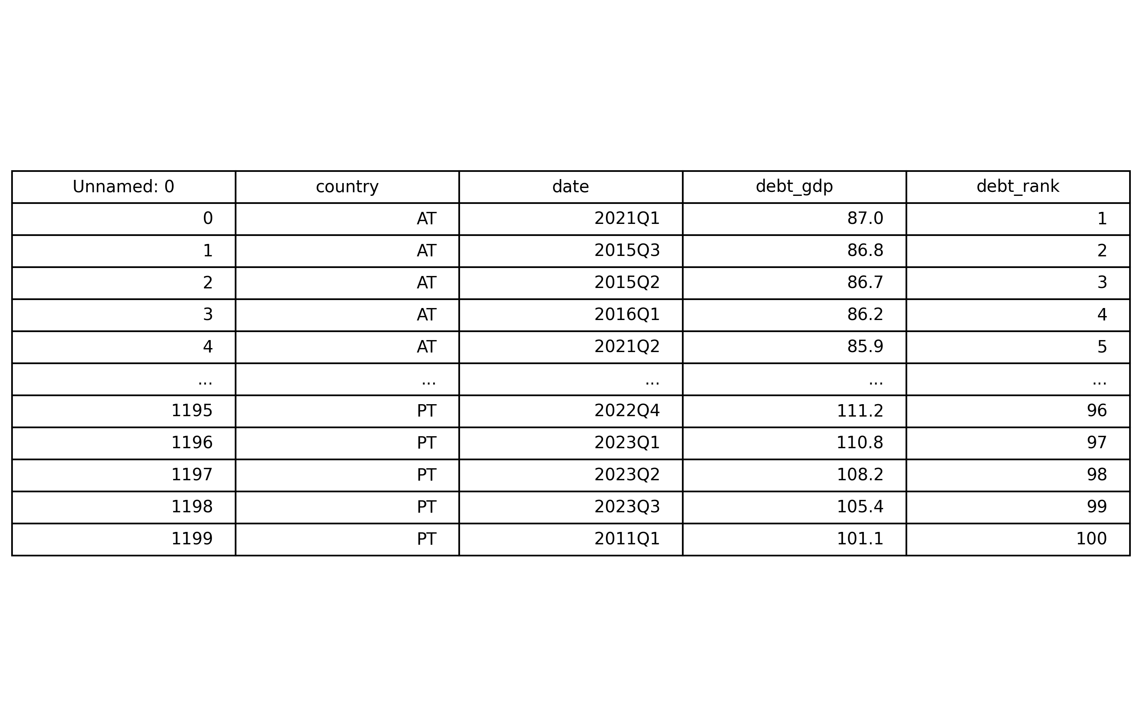
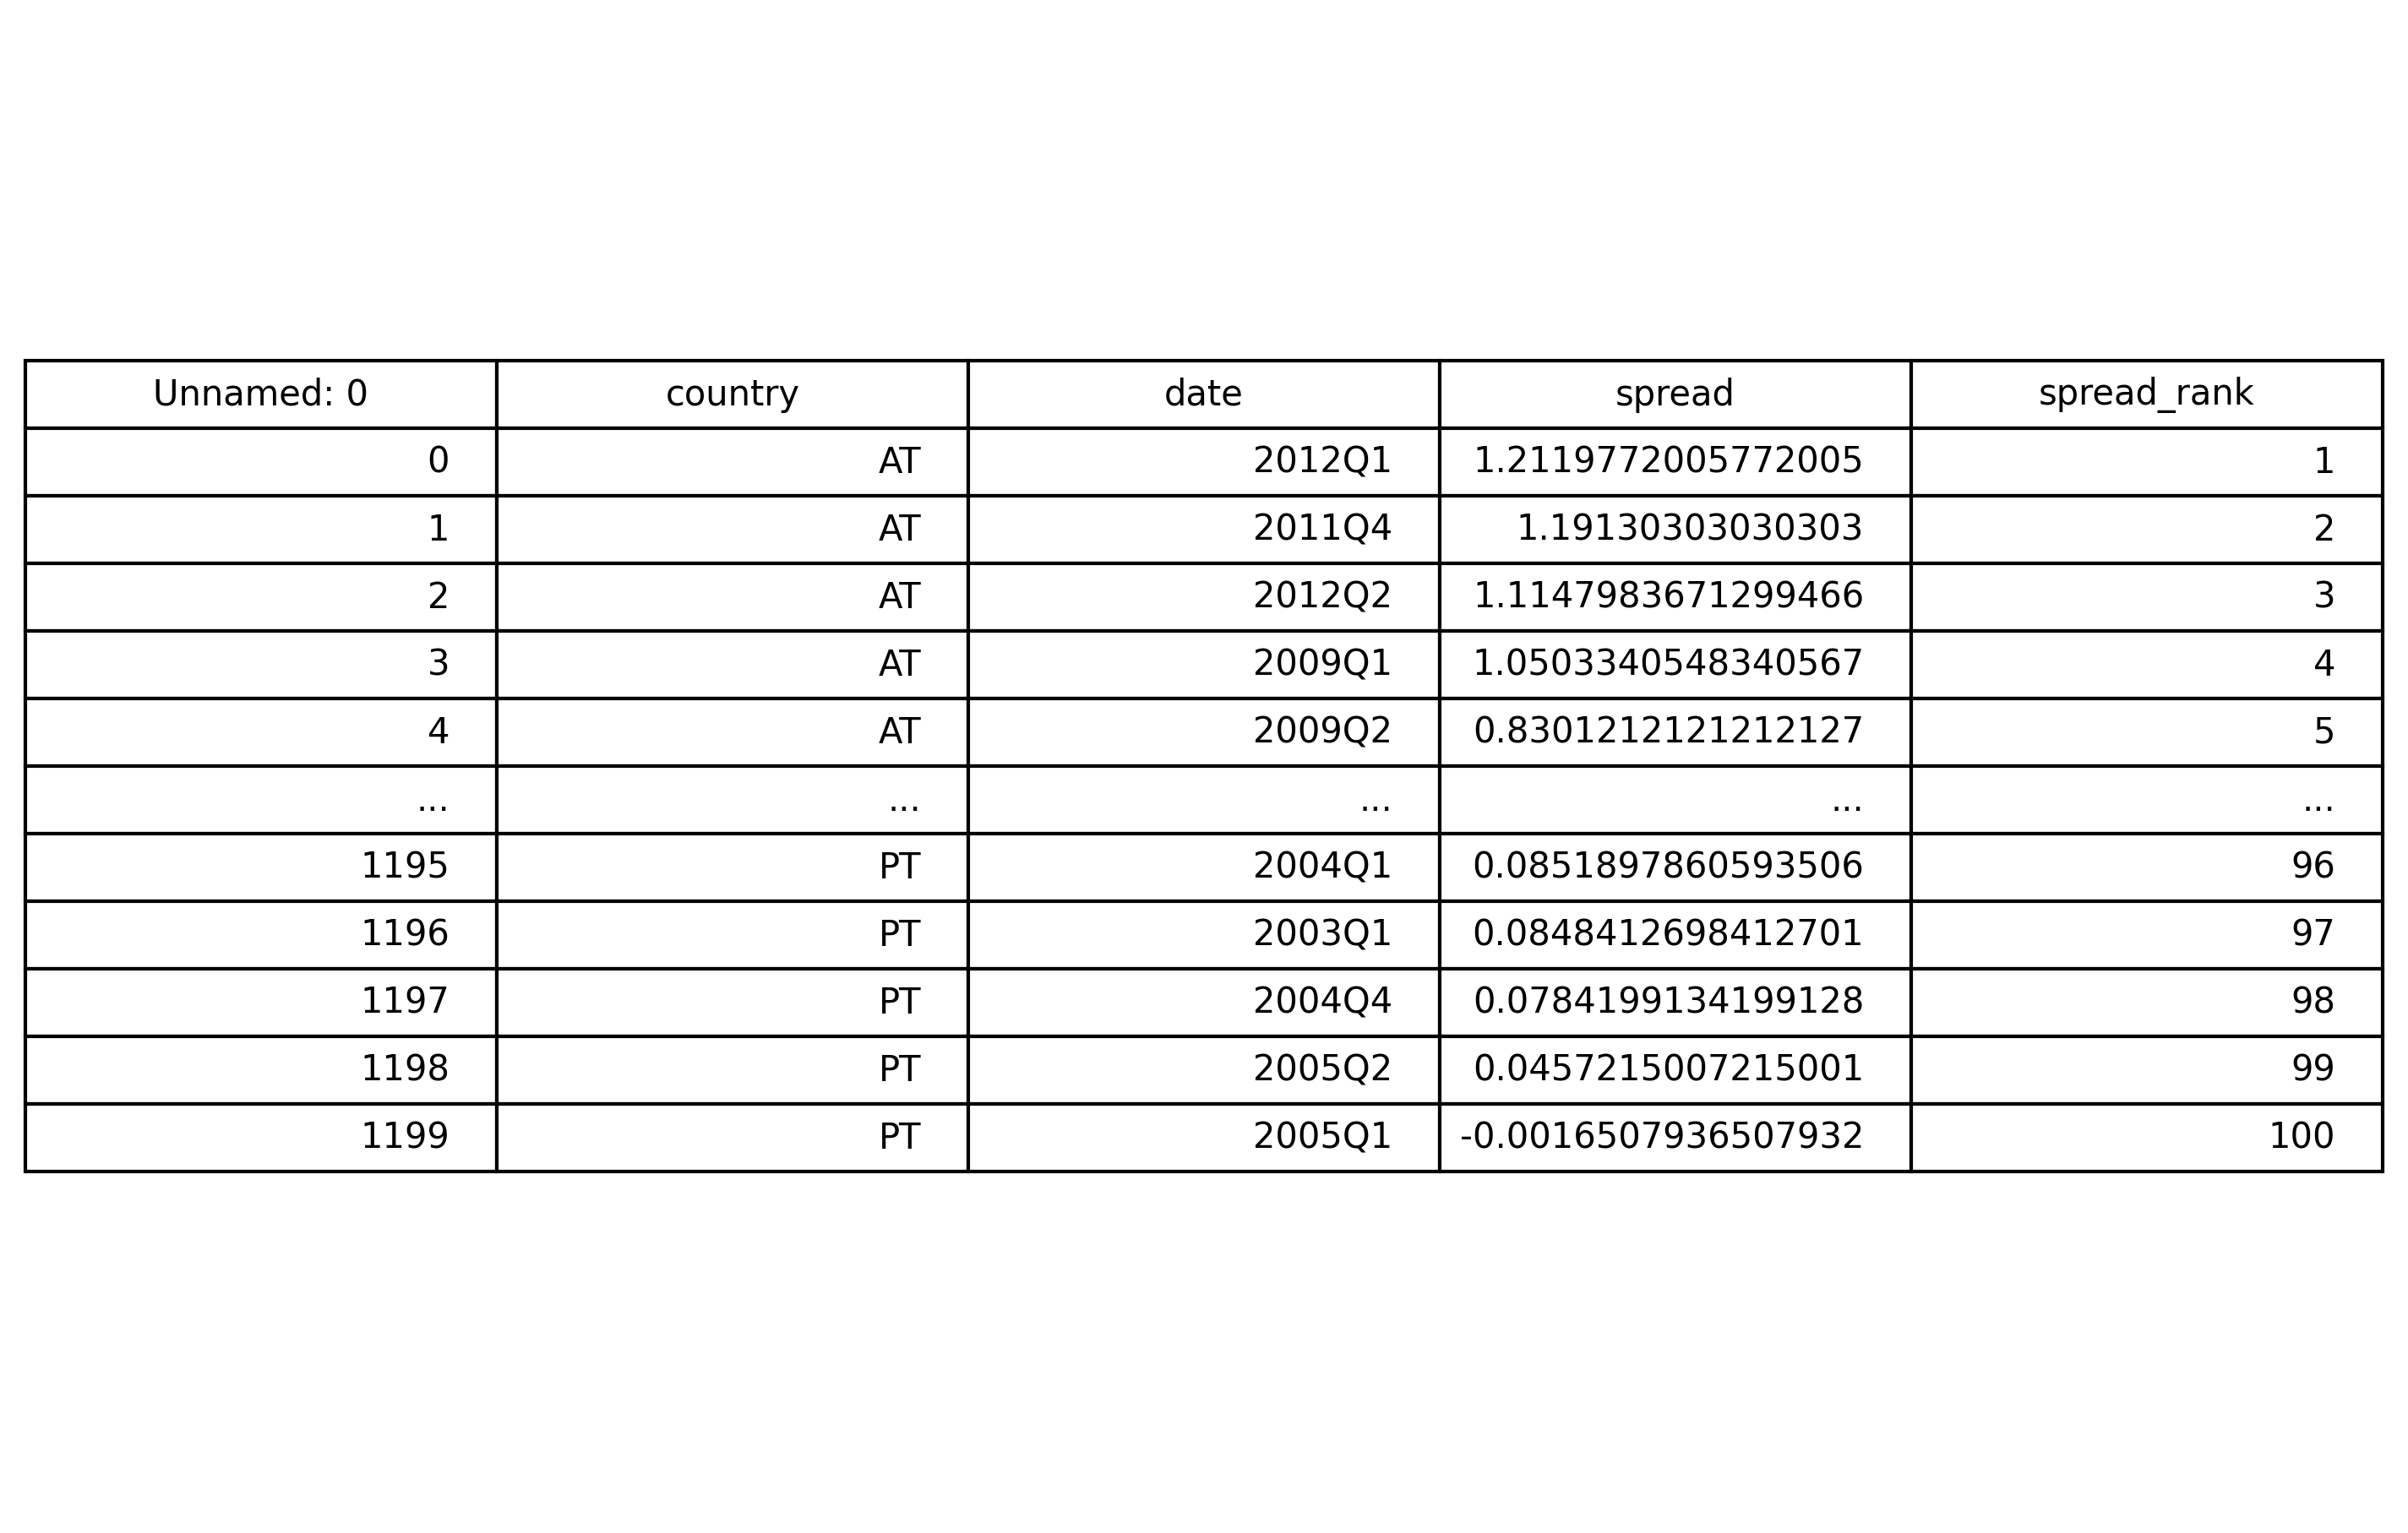
Debt, GDP, and Spread
The country with the lowest debt-to-GDP ratio was Austria in 2021 Q1 (87). On the other hand, the country with the highest debt-to-GDP ratio was Portugal in 2011 Q1 (101.1).
The country with the highest spread was Austria in 2012 Q1 (1.2), whereas the country with the lowest spread was Portugal (-0.002) in 2005 Q1.

Slide 6
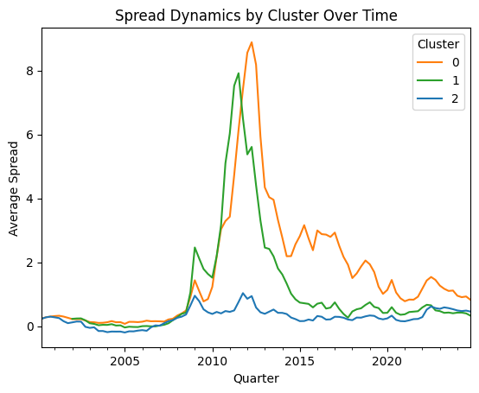
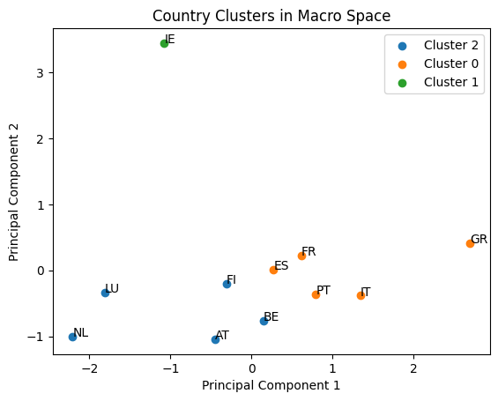
First results I

Slide 7
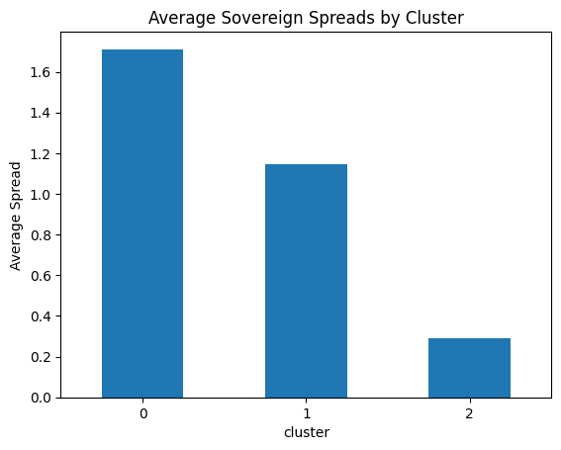
First results II
Cluster 0 exhibits the highest average sovereign spreads and the strongest spike during the sovereign debt crisis, indicating that these countries are perceived by markets as relatively riskier borrowers. In contrast, Cluster 2 maintains consistently low spreads over time, while Cluster 1 occupies an intermediate position, suggesting moderate risk levels between the high-spread and low-spread country groups.

Slide 8
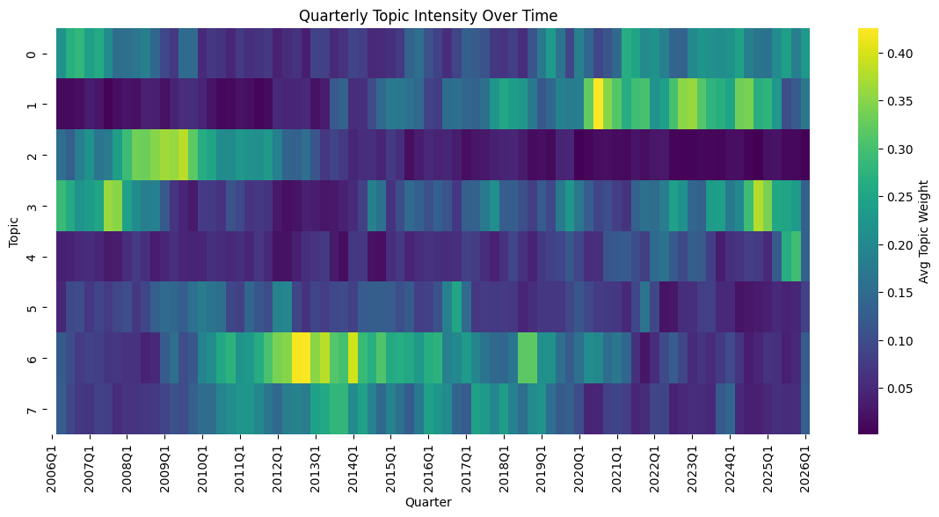
Central Bankers Topics
Topic 0 | Global Integration
Topic 1 | Inflation
Topic 2 | Monetary opperations
Topic 3 | Macroeconomics
Topic 4 | Digital Euro
Topic 5 | Financial Policy
Topic 6 | EMU Governance
Topic 7 | Banking Supervision

Slide 9
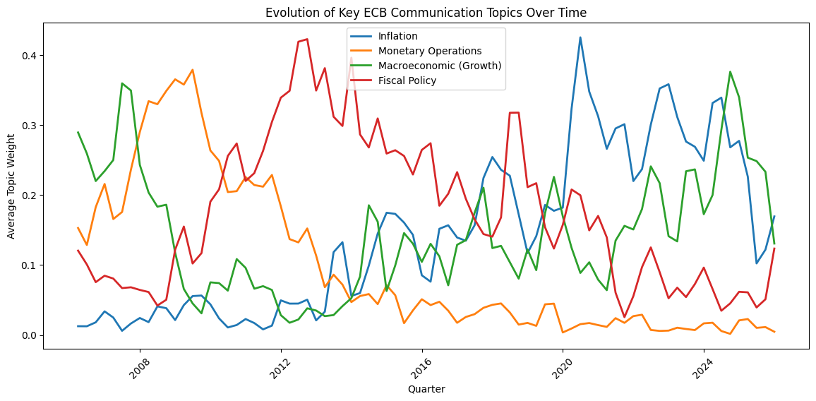
Central Bankers Topics
Central bank communication clearly adapts to changing macroeconomic conditions and major economic shocks. The evolution of topic weights shows that the focus of speeches shifts substantially over time, reflecting the challenges faced by policymakers. In particular, the dynamics appear to be largely driven by monetary and fiscal policy topics, which dominate the communication agenda during periods of economic stress.
Overall, the results suggest that ECB communication is highly responsive to the economic environment, with policymakers adjusting the thematic emphasis of their speeches to address the most pressing economic risks and policy challenges
Period I Aftermath of the Great Financial Crisis and the onset of the European sovereign debt crisis (2012).
Period II COVID-19 (2020) and the energy price shock (2022) , leading to elevated inflation in Europe.

Slide 10
Next steps
Vectorize the results: Construct time series of topic intensities from central bank speeches.
1
Estimate dynamic models to study the relationship between speech topics and sovereign spreads, e.g.:
VAR / SVAR models- Local projections (Jordà impulse responses) Panel VAR across countries
2
Identify similarities and differences in how financial markets and central bankers respond to economic shocks.
3
Contribute to the ongoing debate on whether a systematic gap exists between central bank priorities and financial market perceptions.
4

